Slide 1

PG Management System
Internship Review - 1
Priyanshi Kantariya
22BCE141
B.Tech CSE
Internal Guide: Prof. Monika G Shah
External Guide: Vivek Brahmabhatt
Company: Urukrama Innovations Pvt. Ltd
Notes:
Good morning everyone. I am Priyanshi Kantariya. I am doing my internship at Urukrama innovations as a Software Engineer. The project assigned to me is PG management system.

Slide 2
Table Of Contents
Objective of Project
Scope of First Review
Functional Requirements
Non-Functional Requirements
Tools and Technologies
Flowchart
UML Diagrams
Target for Next Review
References
Notes:
Before we move ahead, please take a moment to look at what I will be covering today.

Slide 3
Objective of Project
Develop a comprehensive web-based PG (Paying Guest) Management System
Digitize and streamline property management operations for PG owners
Provide tenants with a self-service portal for bills, complaints, and profile management
Enable public users to browse properties and request visits online
Implement role-based access control for Admin, Tenant, and Visitor roles
Notes:
The main goal of this project is to digitize and streamline day-to-day PG operations. The goal was to design a public portal where users can browse available PG properties and request visits. For existing tenants, there should be a self-service portal that allows them to view and download bills, track payments, and raise complaints without manual coordination. On the administrative side, the system should provide a centralized dashboard to manage properties, tenants, billing, and complaints efficiently. All these modules should be secured well enough to ensure data privacy and proper authorization.

Slide 4
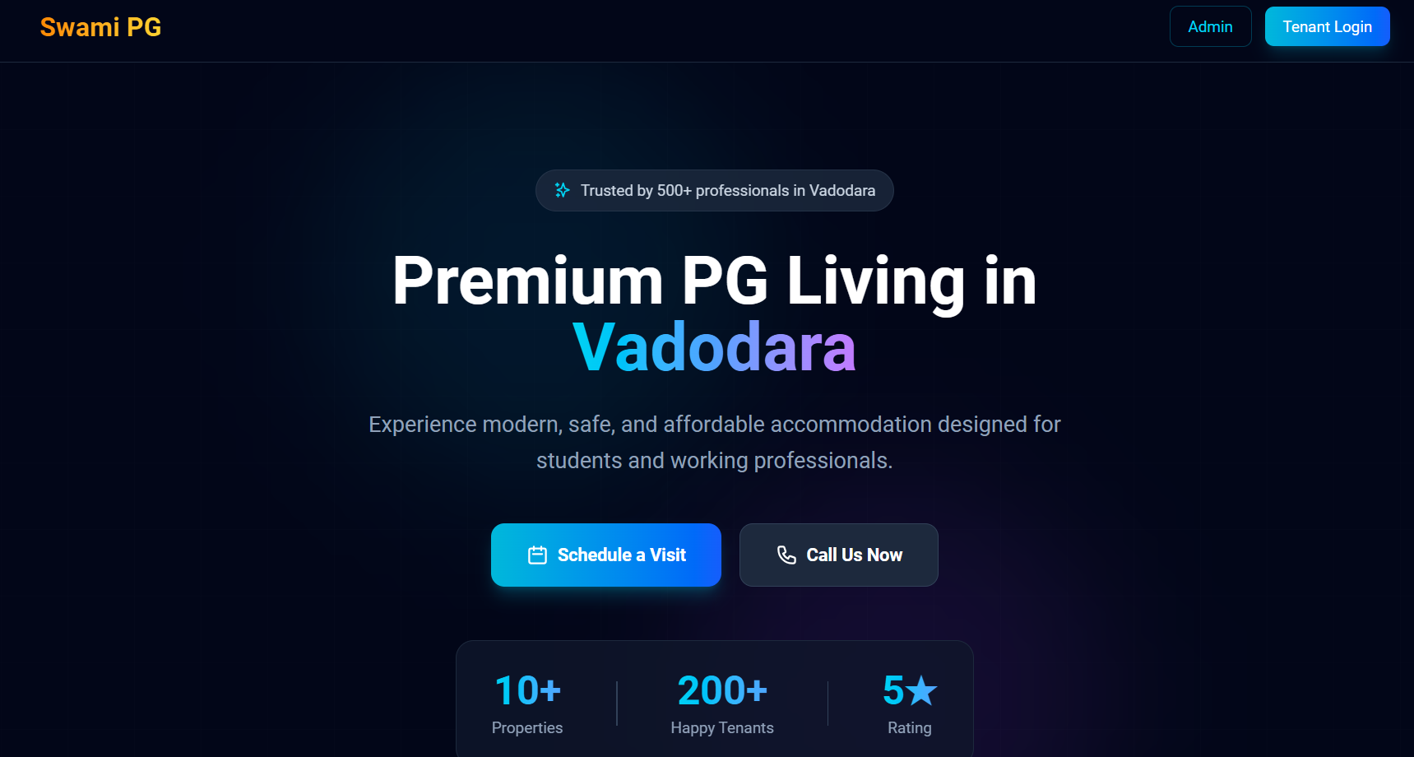
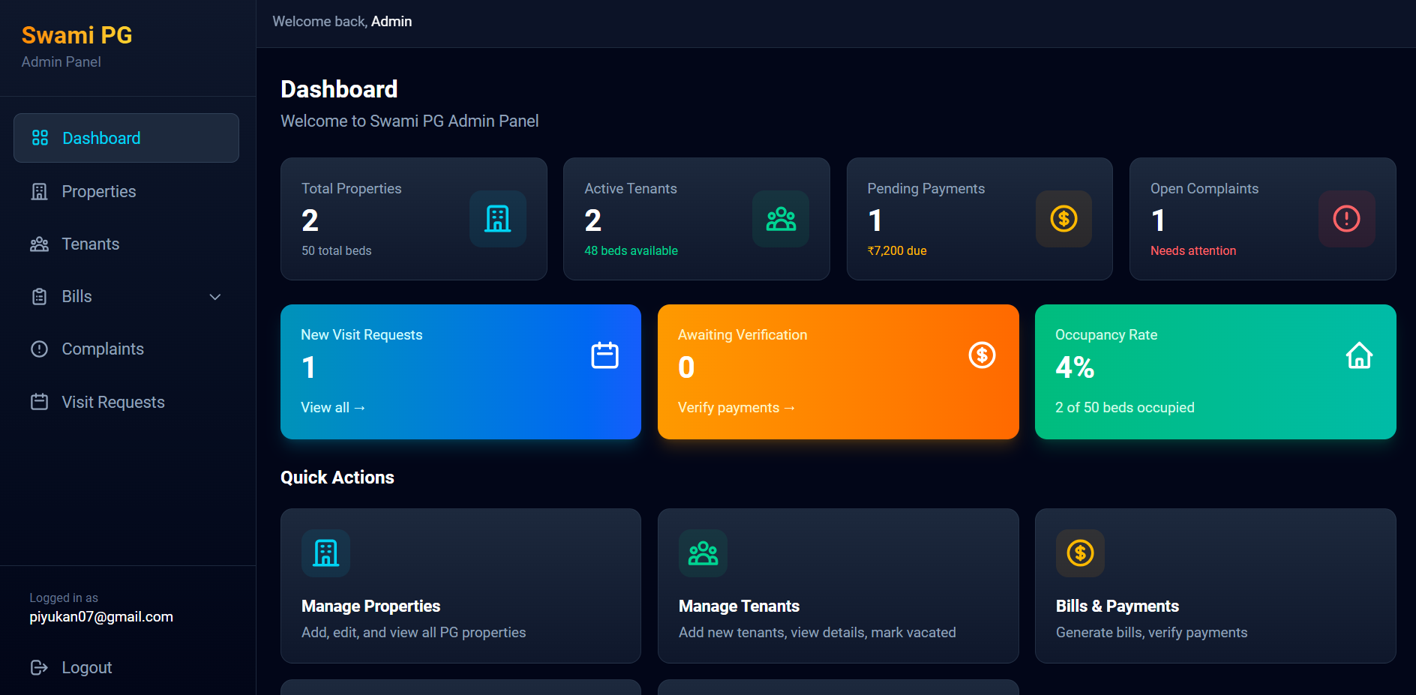
Scope of the First Review
Public Portal
Admin Dashboard
Notes:
For this review we completed the public portal, the admin dashboard, the tenant portal, and basic role-based access control.

Slide 5
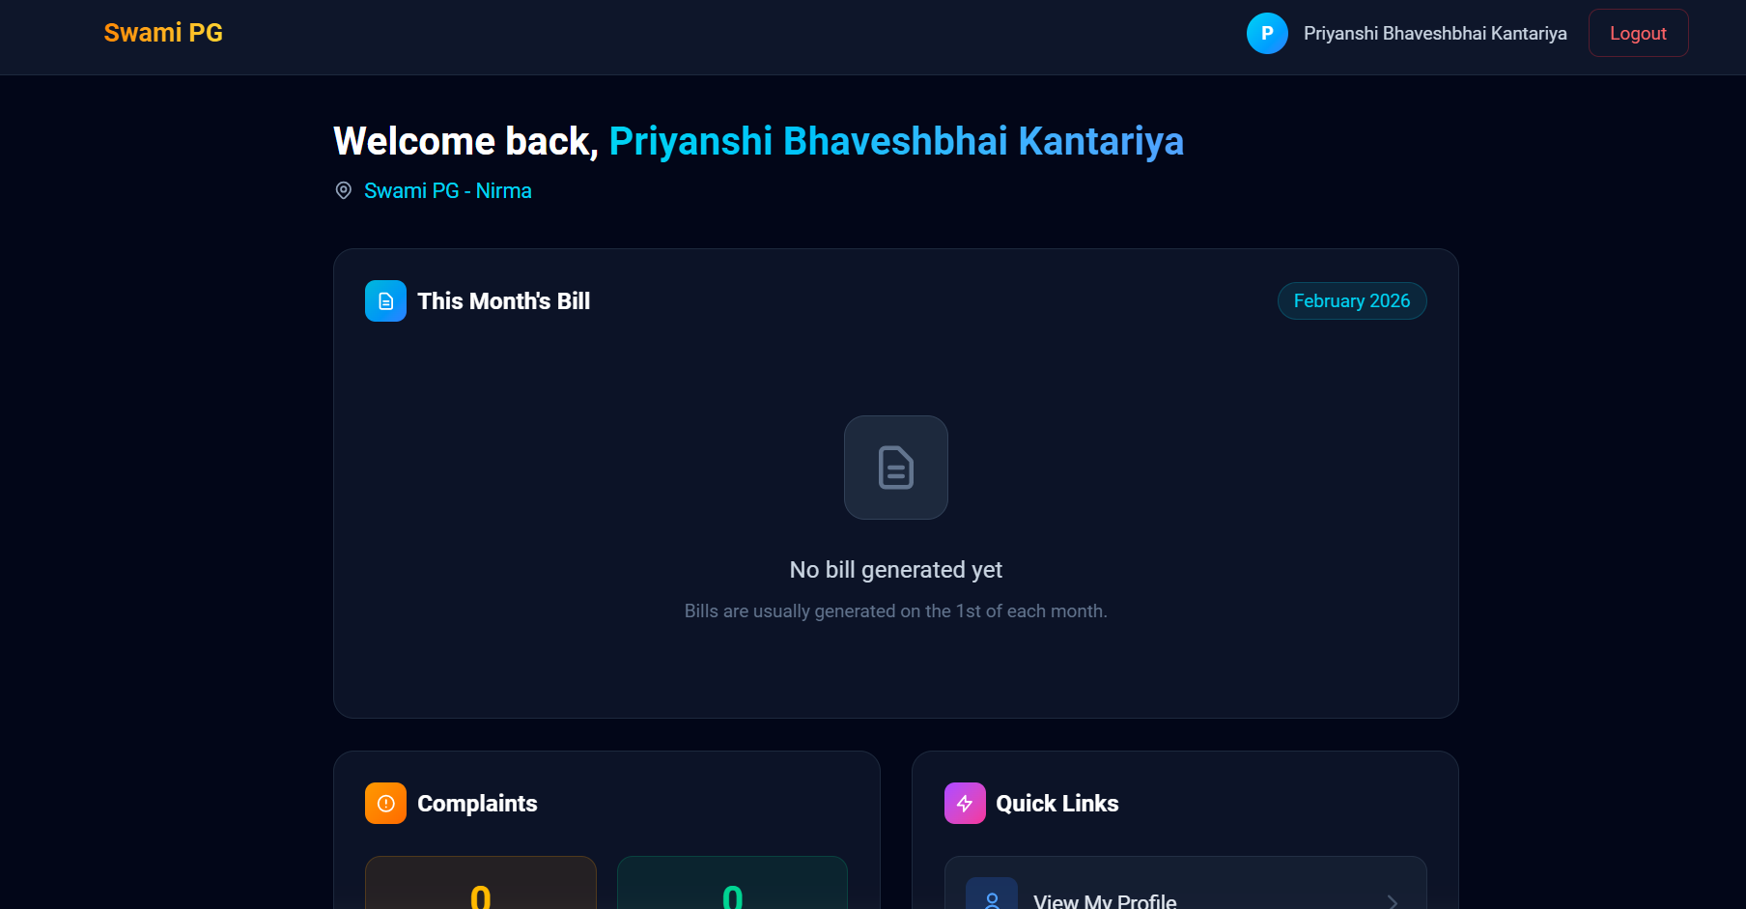
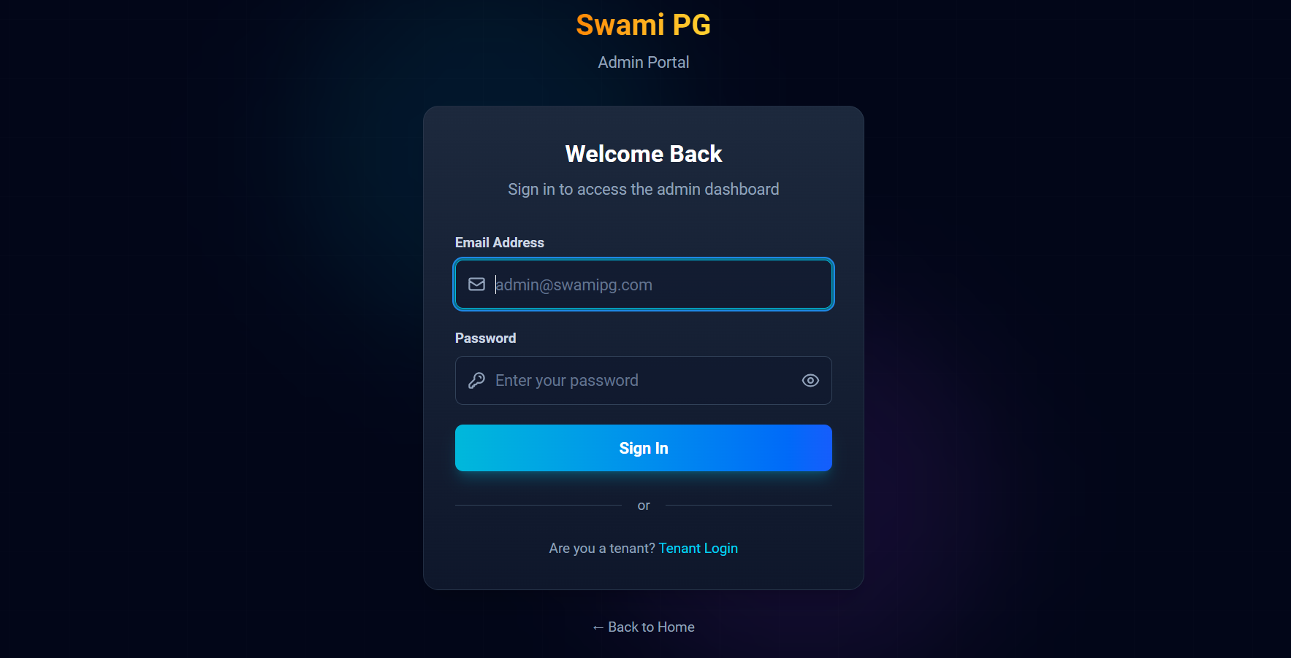
Scope of the First Review
Tenant Portal
Role based Access Control

Slide 6
Functional Requirements
Admin Module
Admin login with secure authentication
PG properties and rooms
View and manage tenant details
Generate and manage monthly bills
Track payment status (paid/unpaid)
Tenant Module
Tenant login with secure authentication
View personal dashboard with room details
View and download monthly bills
Make or track rent payments
Public Module
Browse available PG properties
View property details and amenities
Submit property visit requests
Interact with AI chatbot for queries
Common/System
Role-based access control
Real-time data synchronization
Secure file/image uploads
Responsive UI for all devices
Automated notifications
Notes:
In terms of functional requirements, I focused on covering the complete user journey. I implemented property browsing so users can view PG details, availability, and basic information, along with an option to request a visit. For tenants, I added secure login and a dedicated dashboard where they can view and download bills, check payment history, and track dues. I also included a complaint management feature that allows tenants to raise issues and monitor their status instead of relying on manual follow-ups. On top of this, I planned an AI-based chat interface to handle common tenant queries quickly and reduce repetitive administrative work.

Slide 7
Non-Functional Requirements
Category | Requirement
Performance | Page load time < 3 seconds
Scalability | Support 100+ concurrent users
Security | Firebase Auth with secure rules
Usability | Mobile-responsive design
Reliability | 99.9% uptime (Firebase SLA)
Maintainability | Modular component architecture
Compatibility | All browsers
Data Integrity | Real-time sync with Firestore
Notes:
For non-functional requirements, I focused on making the system practical, reliable, and easy to use. To keep page load time under three seconds, I used a lightweight frontend setup with React and Vite, optimized component rendering, and avoided unnecessary API calls. To support more than a hundred concurrent users, I relied on Firebase’s scalable backend services, which automatically handle traffic spikes without manual server management. For security, I implemented Firebase Authentication and role-based access control, ensuring that users can only access data relevant to their role. I also designed the entire interface to be fully responsive, so it works smoothly across desktops, tablets, and mobile devices. In terms of reliability, I aligned the system with Firebase’s service-level guarantees, which helps ensure consistent availability and data integrity.

Slide 8
Tools and Technologies
Category | Technology | Purpose
Frontend | React 19 | UI Components & State
Build Tool | Vite 7 | Fast Development Server
Styling | TailwindCSS | Utility-first CSS
Backend | Firebase | BaaS Platform
Database | Firestore | NoSQL Real-time DB
Auth | Firebase Auth | User Authentication
Hosting | Vercel | Deployment Platform
Version Control | Git/GitHub | Source Code Management
Notes:
For tools and technologies, I selected a stack that balances development speed, scalability, and simplicity. I used React 19 with Vite for the frontend because it offers fast builds and a clean component-based structure, which helped me manage the UI efficiently. Tailwind CSS was used for styling, as it allowed me to create a consistent and responsive design without writing excessive custom CSS. On the backend, I used Firebase Authentication for secure user login and Firestore as a real-time database, which simplified data synchronization between tenants and admins. For deployment, I used Vercel because it integrates smoothly with React applications and enables quick, reliable hosting with minimal configuration

Slide 9
Application Flow Diagram
Notes:
This diagram explains the overall architecture and user flow of the system. It starts with a user visiting the website and landing on the home page. From there, a user can browse PG properties publicly and submit a visit request without logging in. When authentication is required, the flow clearly separates into tenant and admin paths. For tenants, I’ve shown how they move from login or signup to the tenant dashboard, where they can view bills, raise complaints, update their profile, and report payments. For admins, the flow moves through secure authentication to the admin dashboard, where actions like managing properties, tenants, bills, visit requests, and complaints are handled.

Slide 10
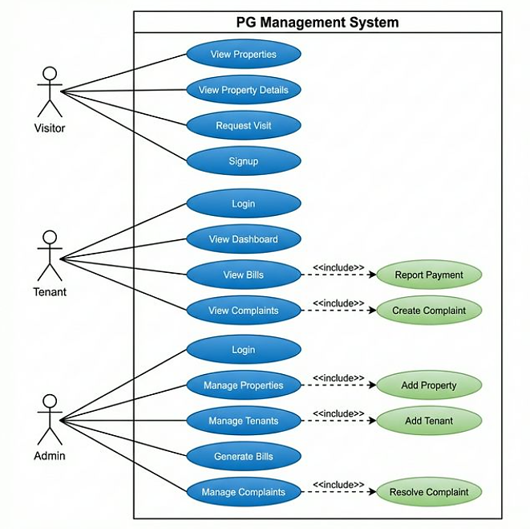
Use Case Diagram
Notes:
This use case diagram shows how different types of users interact with the system. I’ve mainly divided the users into three roles: visitor, tenant, and admin. A visitor can browse PG properties and request a visit without logging in, which keeps the entry barrier low. Once a user becomes a tenant and logs in, they get access to additional features such as viewing and downloading bills, tracking payments, raising complaints, and managing their profile. The admin has the most extensive access. Through the admin dashboard, the admin can manage properties, tenants, billing, visit requests, and complaints. By separating these use cases clearly, I ensured that each user only has access to features relevant to their role, which also aligns with the role-based access control implemented in the system.

Slide 11
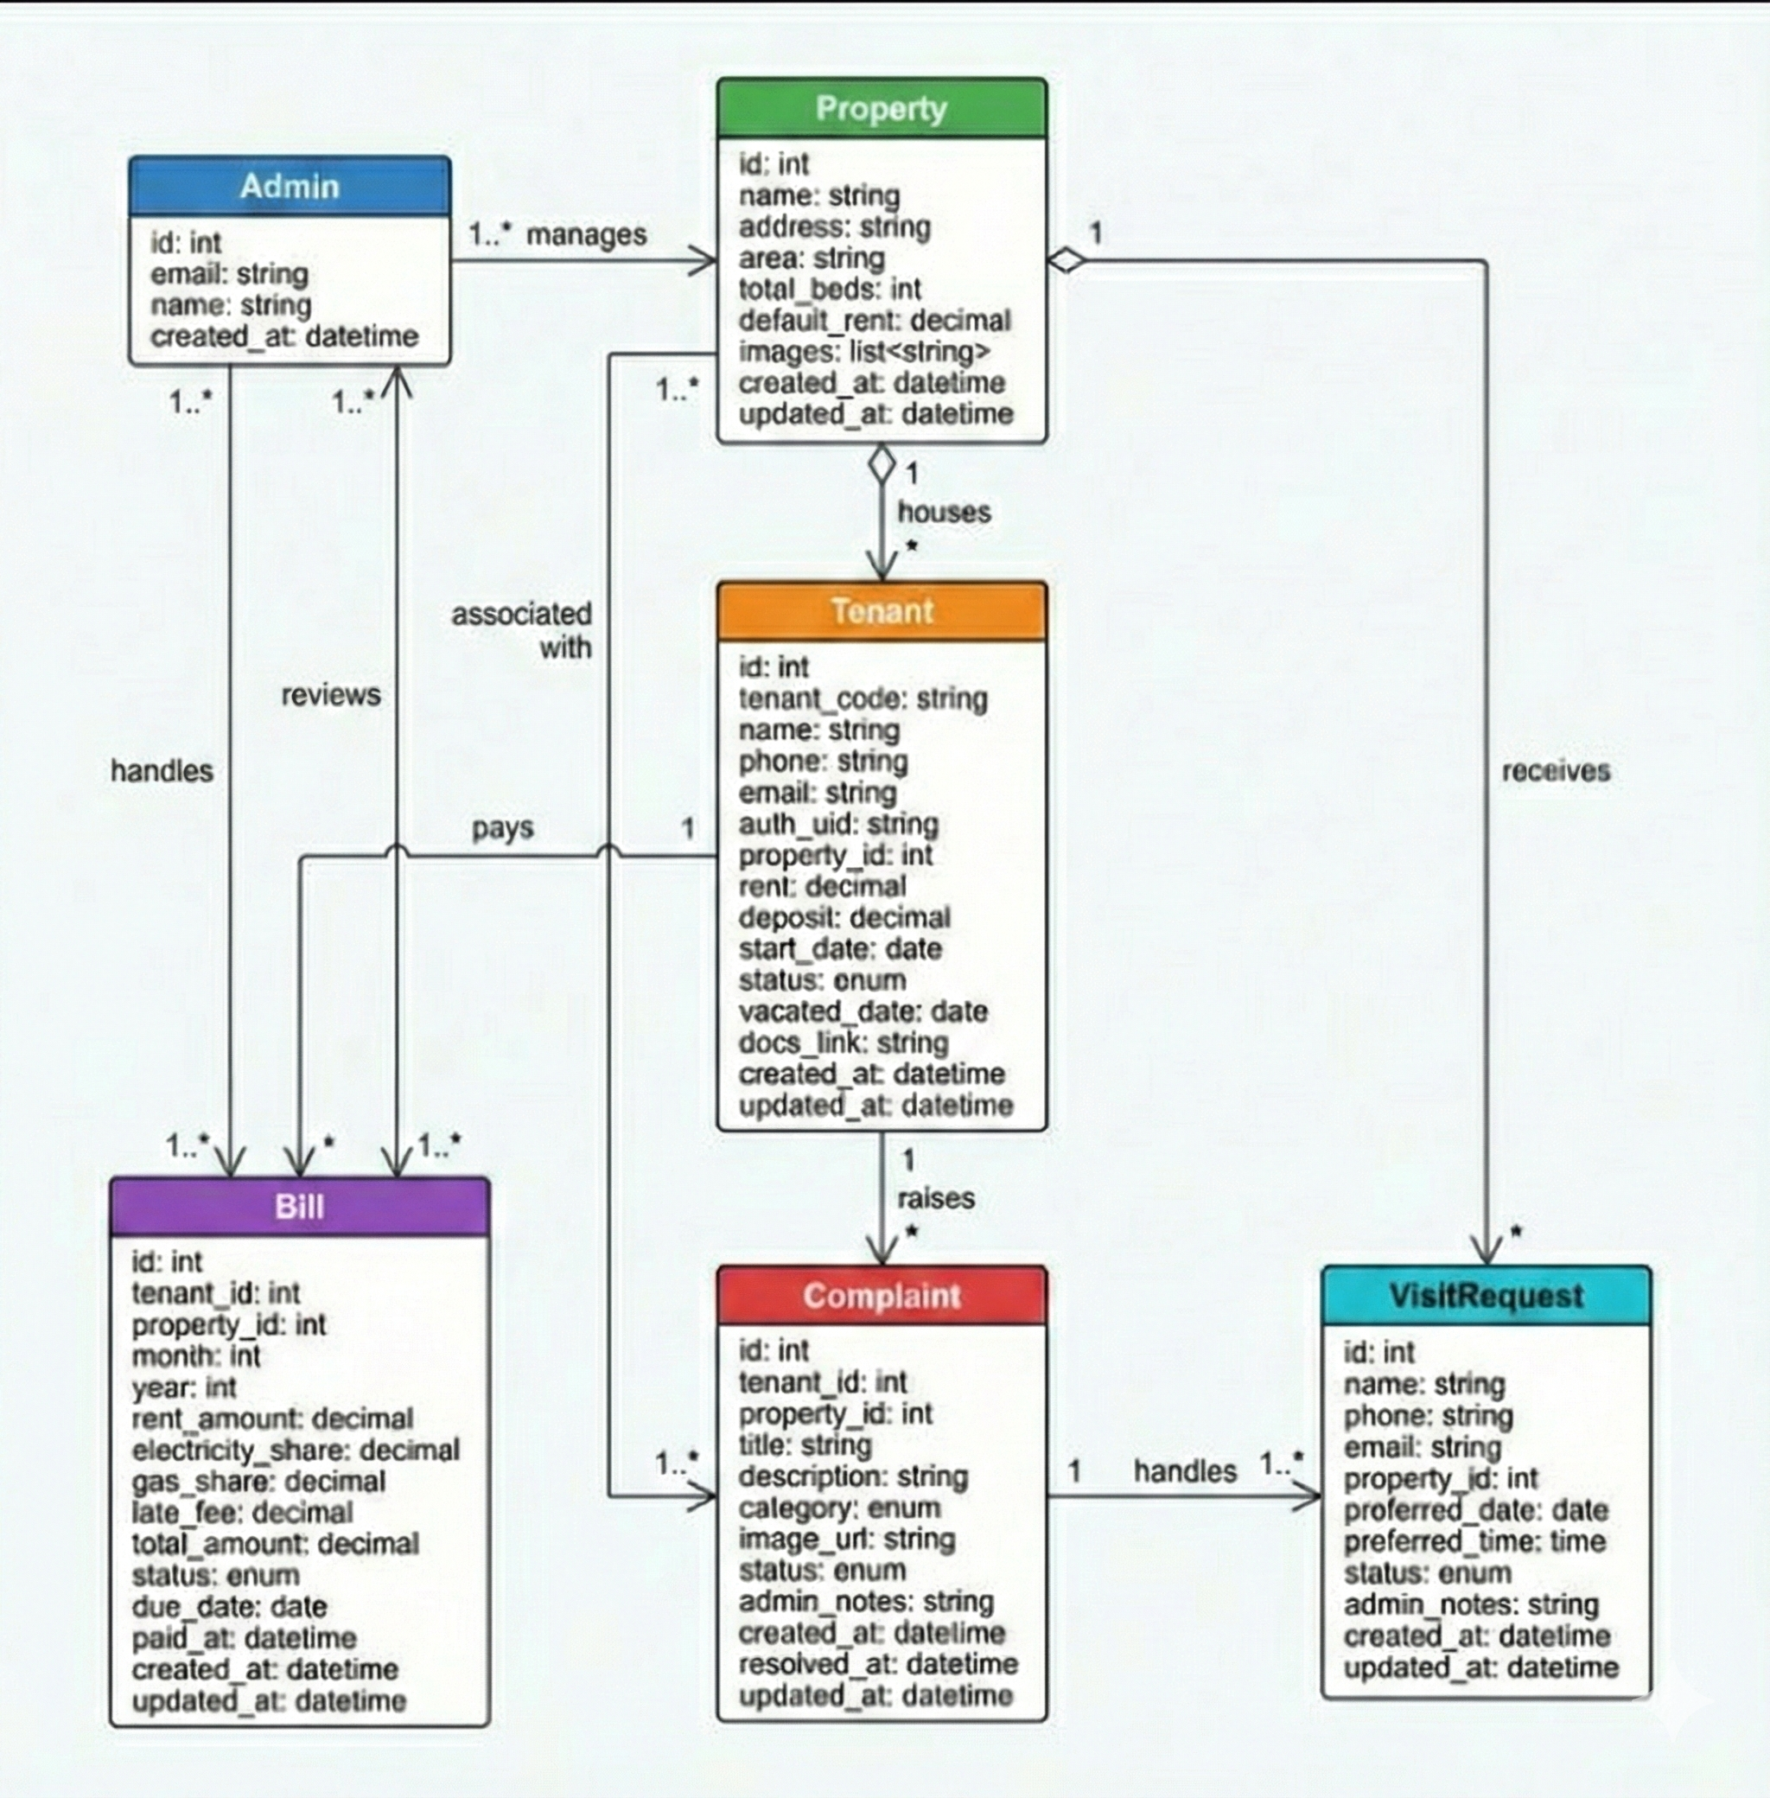
Class Diagram
Notes:
This class diagram represents the core entities of the system and how they relate to each other. I started by identifying the main classes such as User, Tenant, Admin, Property, Bill, Complaint, and VisitRequest. The User class holds common authentication-related information, which is then extended by Tenant and Admin based on role. A Property is associated with multiple tenants, and each tenant can have multiple bills and complaints linked to them. Bills store details like amount, due date, and payment status, while complaints include information such as issue type, description, and current status. Visit requests are linked to properties and help manage scheduling and approvals. This structure helped me design the Firestore data model in a way that keeps relationships clear while avoiding unnecessary data duplication.

Slide 12
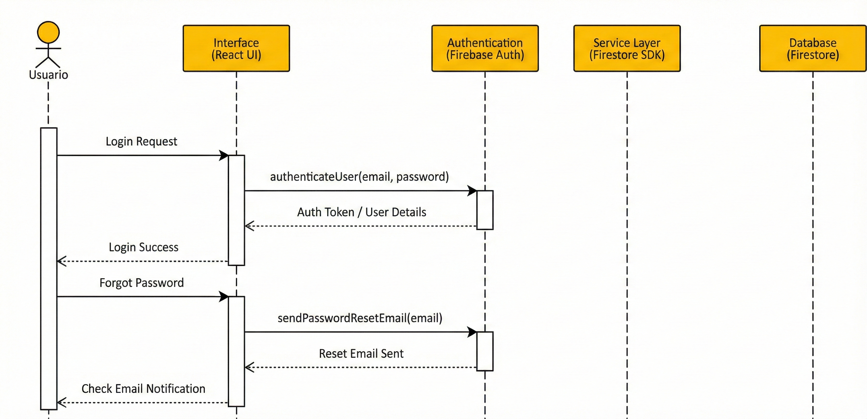
Sequence Diagram(Auth)
Notes:
This sequence diagram shows how different components of the system interact over time for key user actions. I’ve mainly focused on two important flows: authentication and tenant dashboard operations. In the authentication flow, the user initiates a login request from the frontend, which is validated using Firebase Authentication. Once the credentials are verified, the system fetches the relevant user role and redirects the user to the appropriate dashboard.

Slide 13
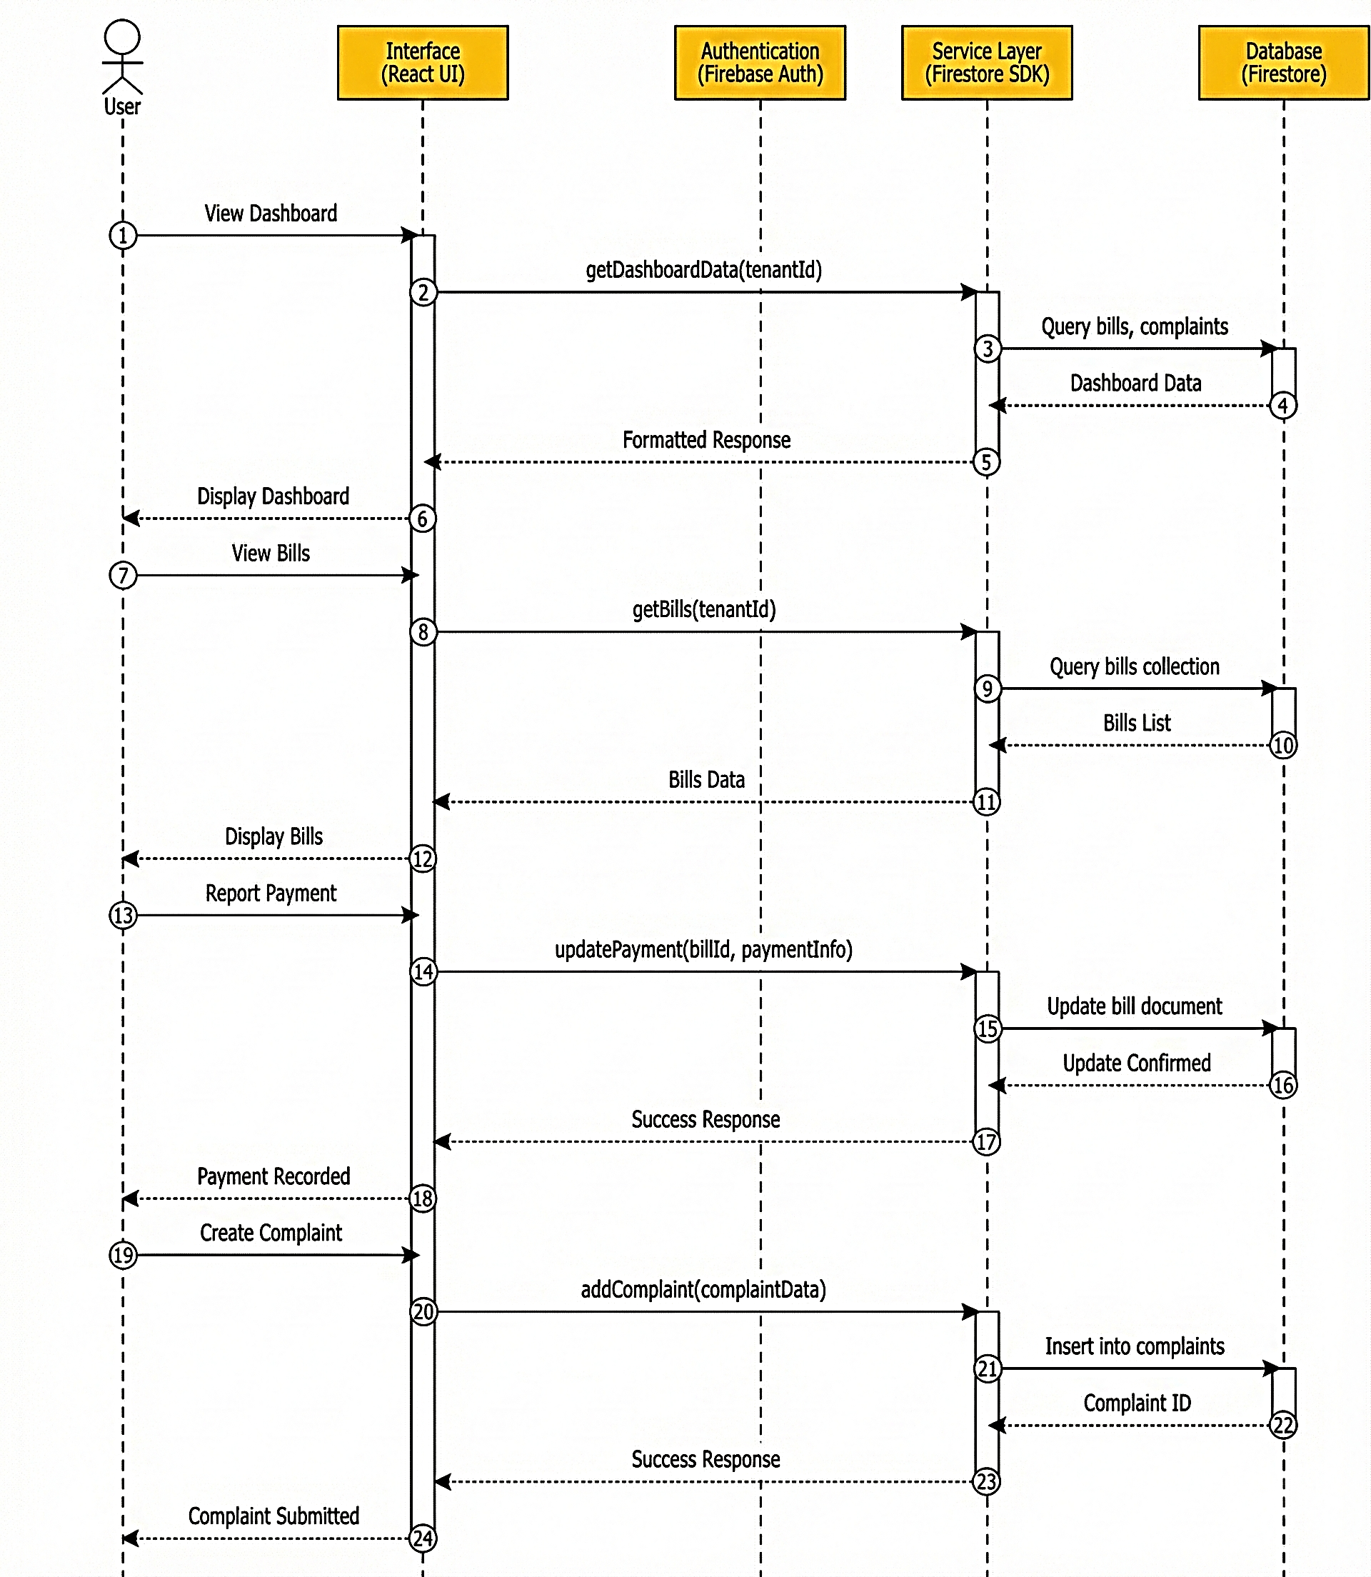
Sequence Diagram (Tenant)
Notes:
In the tenant dashboard flow, when a tenant requests data such as bills or complaints, the frontend sends a request to Firestore, retrieves the data in real time, and displays it on the dashboard. Actions like raising a complaint or reporting a payment follow a similar sequence, where the request is written to Firestore and reflected instantly for the admin

Slide 14
Target For Next Review
Develop a AI chat bot component with a message input field and chat layout for users to interact with.
Implement basic keyword-based response logic to handle common tenant queries like rent details, wifi password, and complaint status.
Integrate chat history storage with Firestore to persist conversations for future reference and analysis.
Enable real-time notification to admin panel when a new chat query is received from a tenant.
Notes:
For the next review, my focus is on improving communication and support within the system. I plan to develop an AI chat component with a proper message input field and a chat-style layout, so tenants can interact with it in a simple and familiar way. Initially, I will implement basic keyword-based response logic to handle common and repetitive queries such as rent details, Wi-Fi credentials, and complaint status. Along with this, I will integrate chat history storage using Firestore, which will allow conversations to be saved and reviewed later for analysis or follow-up.

Slide 15
References
[1] React Documentation. (2026). React – A JavaScript library for building user interfaces. https://react.dev/
[2] Firebase Documentation. (2026). Firebase Documentation. https://firebase.google.com/docs
[3] TailwindCSS. (2026). A utility-first CSS framework. https://tailwindcss.com/
[4] Vite. (2026). Next Generation Frontend Tooling. https://vitejs.dev/

Slide 16
Thank You!
Questions & Discussion

